Slide 1
Organization Structure: Departmentation
Session 13

Slide 2
Definition
An organizational structure defines how activities such as task allocation, coordination, and supervision are directed toward the achievement of organizational aims.
Grouping activities and people into departments makes it possible to expand organizations.

Slide 3
Department by Enterprise function
Grouping of activities according to the functions of an enterprise, such as production, sales, financing, HR and Marketing.

Slide 4
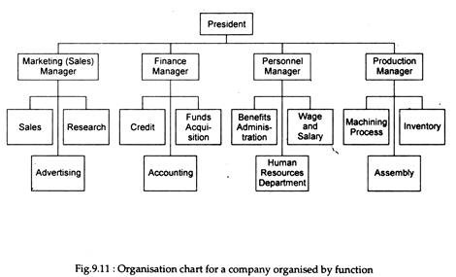

Slide 5
Advantages:
Logical reflection of functions
Maintains power and prestige of major functions
Follows principle of occupational specialization
Simplifies training
Disadvantages:
De-emphasizes overall company objectives
Slow adaptation to changes in the environment

Slide 6
Departmentation by Territory or Geography
Grouping of activities by territory or area is common in enterprises operating over wide geographic areas.

Slide 7
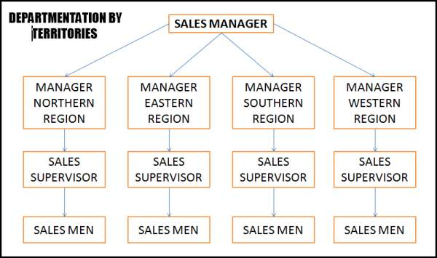

Slide 8
Advantages:
Places emphasis on local markets and problems
Improves co-ordination in a region
Takes advantage of economies of local operations.
Better face-to-face communication with local interests
Disadvantages:
Requires more persons with general manager abilities
Makes control more difficult for top management.

Slide 9
Departmentation by customer group
Grouping of activities that reflects a primary interest in customers.

Slide 10
President
Community city banking
Real estate and mortgage loans
Agriculture banking
Institutional banking
Corporate banking

Slide 11
Advantages:
Encourages focus on customer needs
Gives customers the feeling that they have an understanding supplier
Develops expertise in customer area
Disadvantages:
Requires managers and staff expert in customer’s problems
Customer groups may not always be clearly defined

Slide 12
Departmentation by Product
Grouping of activities according to products or product lines, especially in multiline, large enterprises.

Slide 13
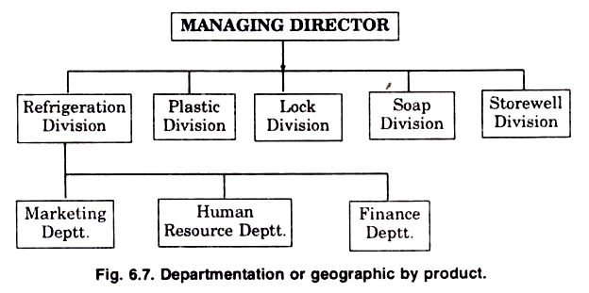

Slide 14
Advantages:
Permits growth and diversity of products and services.
Improves coordination of functional activities
Places responsibility for profits at the division level
Disadvantages:
Requires more persons with general manager abilities
Presents increased problem of top management control

Slide 15
Matrix Organization
The combining of functional and project or product patterns of Departmentation in the same organization structure.

Slide 16
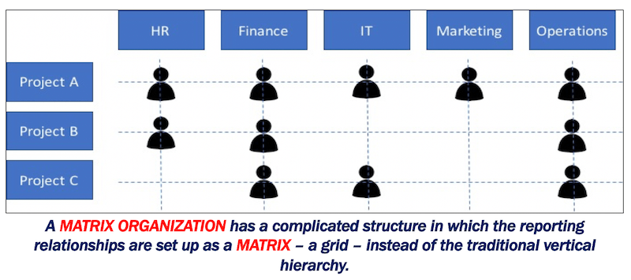

Slide 17
Strategic Business Units(SBU)
Distinct businesses set up as units in a larger company to ensure that certain products or product lines are promoted and handles as though each were an independent business.

Slide 18
A good example of a corporation having SBUs is the LG. LG as a company produces several consumer products like washing machines, televisions, refrigerators and more others. This units form the SBUs for this company. Their profits can be tracked separately. Each SBU makes its own decisions, budgets and so on

Slide 19


Slide 20
The Virtual Organization
A concept of a group of independent firms or people that are connected through, usually, information technology.

Slide 21
The boundaryless organization
A boundary less organization is a contemporary approach in organization design. It is an organization that is not defined by, or limited to, the horizontal, vertical, or external boundaries imposed by a predefined structure.

Slide 22
The examples of boundary less organizations would be Apple the company try to remove hierarchy to empower employees and teams. The goal in a boundary less organization is to develop greater flexibility and responsiveness to change and to enable the free exchange of information and ideas.

Slide 23
Choosing the pattern of Departmentation
There is no one best pattern to Departmentation, manager must determine
what is best by looking at the situation they face,
the jobs to be done and the way they should be done,
the people involved and their personalities,
the technology employed in the department,
the users being served and
Other internal and external environmental factors in the situation.

Slide 24
The Aim: Achieving Objective
Mixing types of departmentation

